Slide 1

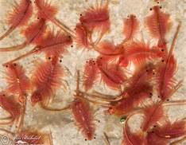
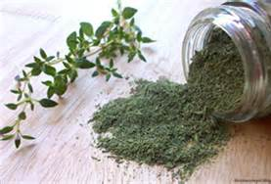
Analysis of Traditional Herbs on Brine Shrimp
Figure 2.
Dry Rosemary
Chyna Johnson
Jaliyah Dean
Ashley Beverly
Jhera Hampton
Tori Wilbon
VA-NC Louis Stokes Alliance for Minority Participation(LSAMP)
Vikings Enhancing STEM
Elizabeth City State University
Elizabeth City, NC
July 26,2013
Figure 1. Brine Shrimp
Figure 3. Dry Thyme

Slide 2
Abstract
Throughout the centuries, people of different nations have used and harbored herbs for medicinal purposes. These various plants help to heal sickness, fight infection, prevent menopausal symptoms, help teeth, gums and oral cavities, mouth ulcers, and boosts memory. Some herbs also have side effects and therefore, one have to be cautious while using these herbs. For example, sage oil should never be consumed without being first diluted in water, the use of sage is also not good for pregnant women and nursing mothers. Among the most commonly used herbs are rosemary and thyme. The purpose of this study is to test the behavior patterns of Brine Shrimp based with the extracts of Thyme and Rosemary. Rosemary will effect the brine shrimp’s behavior, specifically movement more than thyme; however, based on this study the hypotheses was incorrect.

Slide 3
Purpose of Study
Analyze the herb affects of brine shrimp behavior
Test phytochemicals in thyme, rosemary & sage using its extract
Hypothesis:
  Rosemary will affect the brine shrimp’s behavior, specifically movement more than thyme due to anti-oxidants.

Slide 4
Introduction:
About Brine Shrimp
Originates in the Great Salt Lake
Go through 14-17 stages of growth
Between each stage they molt.
Usually take 3-6 weeks
Family: Artemiidae
Genus: Artemia
Can become adults in 8 days if:
  Food is plentiful
  Water is warm

Slide 5
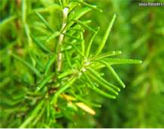
About Rosemary
Family: Limiaceae
Genus: Rosmarinus
Native in the Mediterranean
Medical use is good for:
  Indigestion
  Muscle and Joint Pain
  Alopecia
  Neutralize Foodborne Pathogens
  Improve Memory
Figure 4. Dry Rosemary

Slide 6
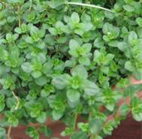
About Thyme
Native to Europe and the Mediterranean
Family of Limiaceae
Genus of Thymus
Thyme Contains:
  Potassium
  Iron
  Calcium
  Manganese
  B complex Vitamins
  Beta Carotenes
  Vitamins A, K, C, E
  Folic Acid
Medical Use:
  Can be used to gargle
  Help with Cavities and Gingivitis
Figure 5. Thyme

Slide 7
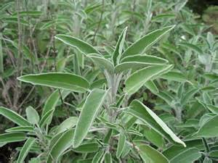
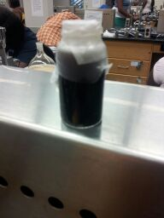
About Sage
Silvery-green plant with leaves that offer a memorable fragrance
Used for kidney disorders
Helps boost memory
Effective herb for teeth, gums, and oral cavity
oil is used in the dose of 1 to 3 drops for respiratory tract
Figure 6. 20 ml of Extract
Figure 7. Green leafy Sage plant

Slide 8
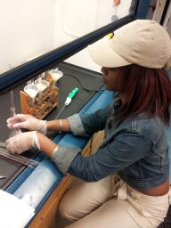
Phytochemical Screening
A process of tracing plant elements
Chemical components occur naturally in plants responsible for
  color and other properties
Figure 8. Phytochemical Screening Process

Slide 9
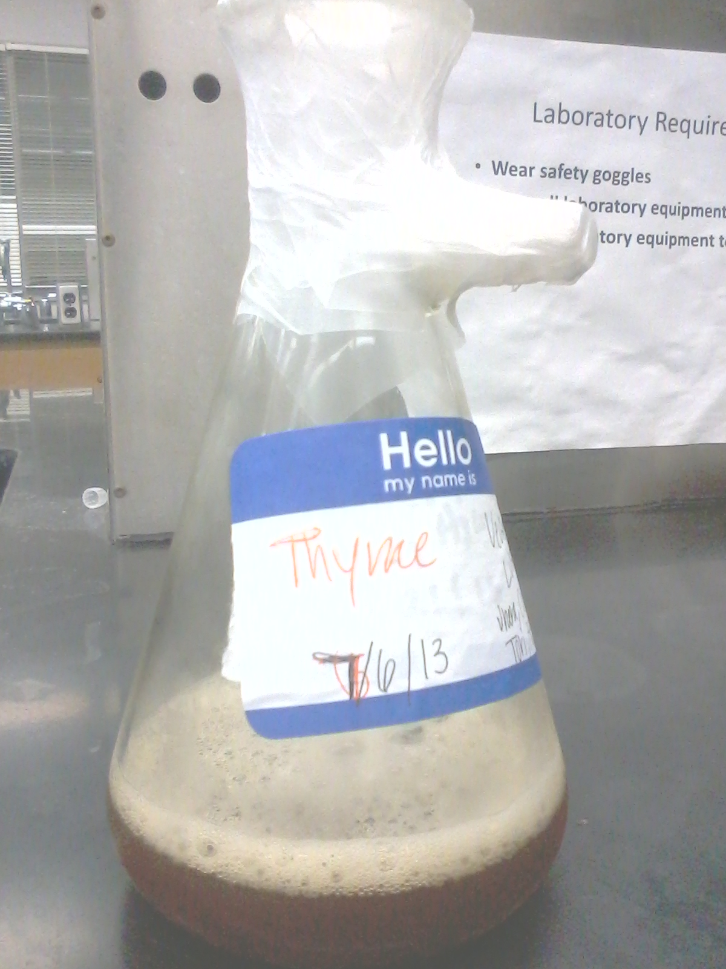
Methodology
July 6, 2013
Refluxing Thyme:
  15.13g of thyme
  150 ml deionized water
  Thyme per Water = 9.91 g/ml
    Water Boil 45%:
      30 min.
  Smell: strong aroma
Figure 9. 9.91 g/ml of Thyme Refluxed

Slide 10
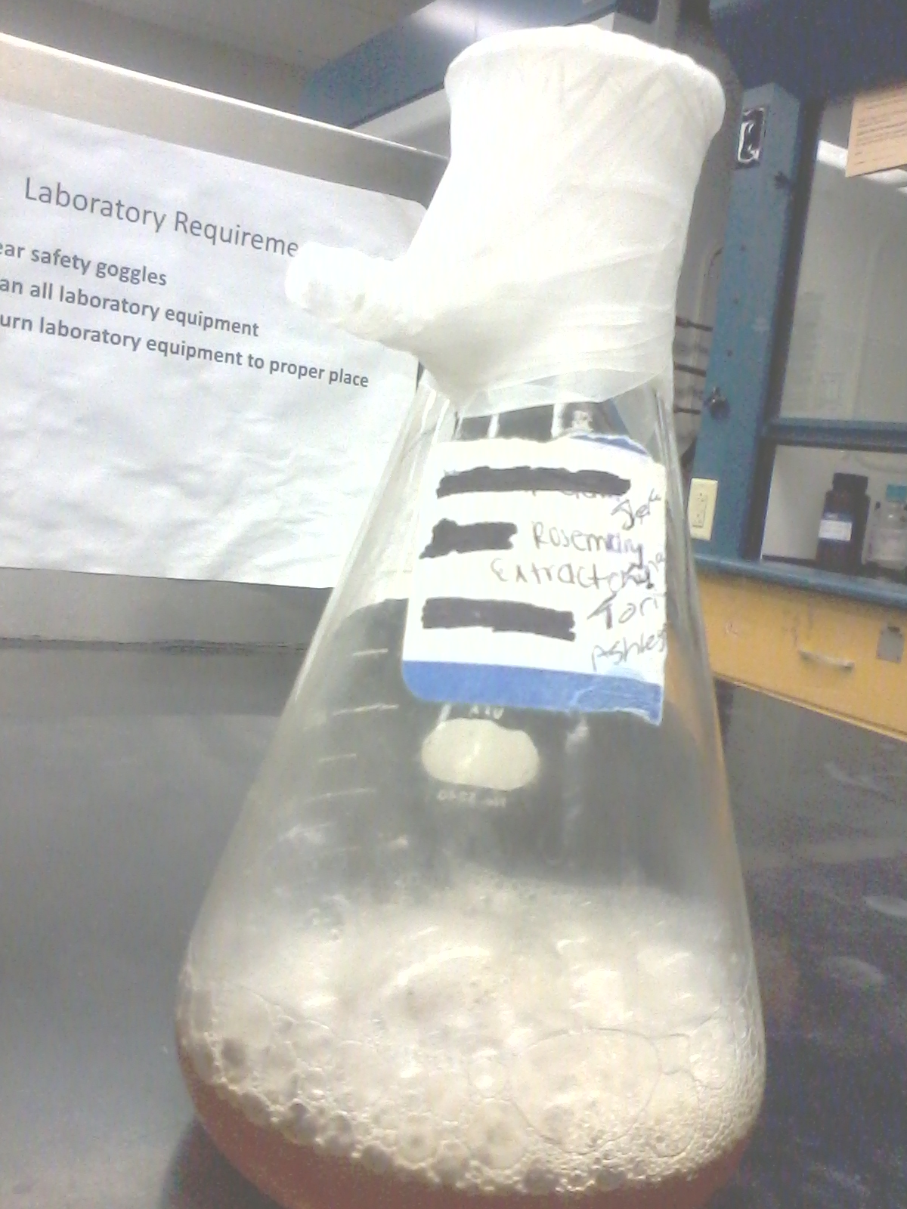
July 8, 2013
Reflux Rosemary
  8.18g of rosemary
  100 mL deionized water
  Rosemary per Water= 12.22 g/ml
    Water Boil:
      32min.
  Smell: strong aroma
Figure 10. 12.22g/ml Rosemary Reflux

Slide 11
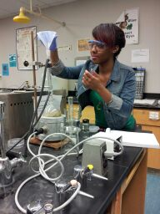
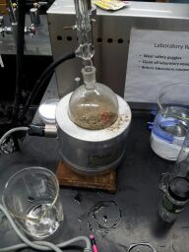
2.7 g out of 20 ml
100 ml deionized water
Smell: Strong aroma
Figure 12. Ja’liyah Dean Sage Reflux Method
Figure 11. Reflux of Sage

Slide 12
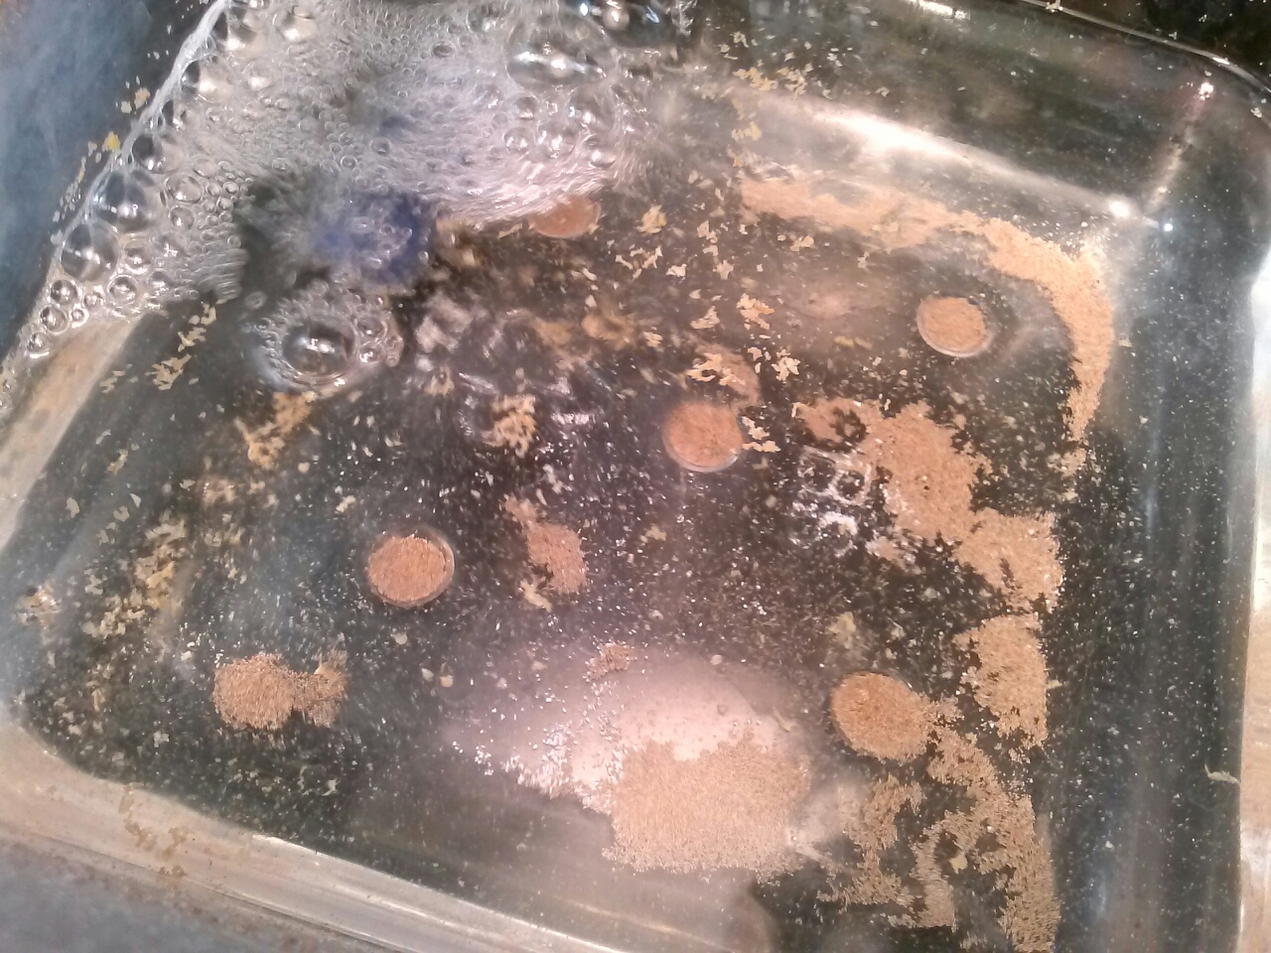
Brine Shrimp Eggs Hatchery
  20.07g salt (tare)
  800 ml deionized water
  48 hrs. to hatch
Figure 13. Brine Shrimp Hatchery

Slide 13
July 11, 2013
Evaporating Samples
  Thyme
    Dry Flask Mass = 135.52
  Rosemary
    Dry Flask Mass = 109.68
Calculation:
  Rosemary
  Thyme
Mass of Flask and Evaporate Sample
  Minus
Mass of Dry Flask
  Equal
Mass of Sample
126.92
- 15.5
111.42
-109.68
1.74 g/20ml
139.64
-135.52
4.12 g/24ml

Slide 14
July 12, 2013
Extractive Value
Calculation:
  Rosemary
  Thyme
Mass of Evaporated Sample
100 x -----------------------------------
Mass of Original Dry Sample
1.74
------ x 100 = 21.27%
8.18
4.12
------- x 100 = 27.23%
15.13

Slide 15
Procedures: Sampling Phytochemical Testing
July 12-13,15, 2013
Phytochemical Testing | Thyme | Rosemary | Sage
Saponins | Weakly Positive | Weakly Positive | Negative
Cardiac Glycosides | Strongly Positive | Positive | Positive
Alkaloids | Positive | Weakly Positive | Positive
Tannins | Positive | Positive | Positive
Anthraquinones | Negative | Negative | Negative
Flavonoids: Lead Acetate | Negative | Negative | Negative
Flavonoids: Ferric Chloride | Negative | Negative | Positive
Flavonoids: Sodium Hydroxide | Positive | Positive | Negative
Table 1. Phytochemical Testing

Slide 16
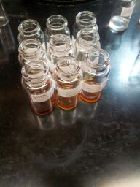
Dilution: Cyto-Toxicity
Insert 10 shrimp in 18 vials each
Inserts 1 ml of each concentration
  3 vials each
Figure 14. Each Concentration in 9 vials

Slide 17
A Concentration
  1ml Sample + 9 ml DMSO
    Rosemary = 8.7 mg/ml
    Thyme = 17.2 mg/ml
B Concentration
  1ml A + 9ml DMSO
    Rosemary = 0.87 mg/ml
    Thyme = 1.72 mg/ml
C Concentration
  1mL B + 9mL DMSO
    Rosemary = 0.087 mg/ml
    Thyme = 0.172 mg/ml

Slide 18
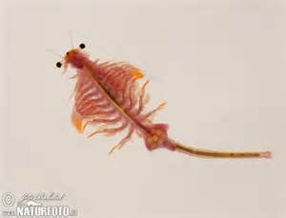
Results
1st Trial
Shrimp died
Insert 1 ml in 2 vials of each concentration
Insert .5 ml in 1 vial of each concentration
Figure 15. Mature Brine Shrimp

Slide 19
2nd Trial
Mortality Rate – Ratio of deaths in population
Control
  40% mortality rate
Concentration for both Thyme and Rosemary
  100% mortality rate
Graph 1 Shrimps’ Mortality Rate

Slide 20
Discussion:
Future Work
Our Hypothesis
Sage
Thyme & Rosemary
After phytochemical testing, there was no more extract left to test.
Further testing on the effects of sage on Mature Brine Shrimp.
Test rosemary & thyme again.
Further testing of other traditional herbs.

Slide 21
References
Ageless. (2012, January 8). Retrieved July 20, 2013, from Rosemary: Rosemarinus officinalis: http://www.ageless.co.za/herb-rosemary.htm
Farmers, I. M. (n.d.). Retrieved July 20, 2013, from Herb Info: Rosemary: http://www.herbinfosite.com/?page_id=20
Gardening, O. (n.d.). Retrieved July 20, 2013, from Thyme: A Growing Guide: http://www.organicgardening.com/learn-and-grow/thyme-a-growing-guide
gr, M. (n.d.). A Modern Herb. Retrieved July 20, 2013, from Thyme, Garden: http://botanical.com/botanical/mgmh/t/thygar16.html

Slide 22
Acknowledgements
Thank You For Helping Our Experiment
Our Lord & Jesus Christ
Dr. Khan Provost
VESTEM, Mr. Townsel
Dean Harry Bass
Mrs. Shante Outlaw
Ms. Jamela Pittman
Ms. Quisha Vaughn
Mr. Clarence Highsmith

Slide 23
Questions??

